Slide 1

ANNUAL GENERAL MEETING
29 October 2023

Slide 2

Welcome everyone
Thank you for coming!
Housekeeping
- fire exits and RVP
- bathrooms
- refreshments

Slide 3
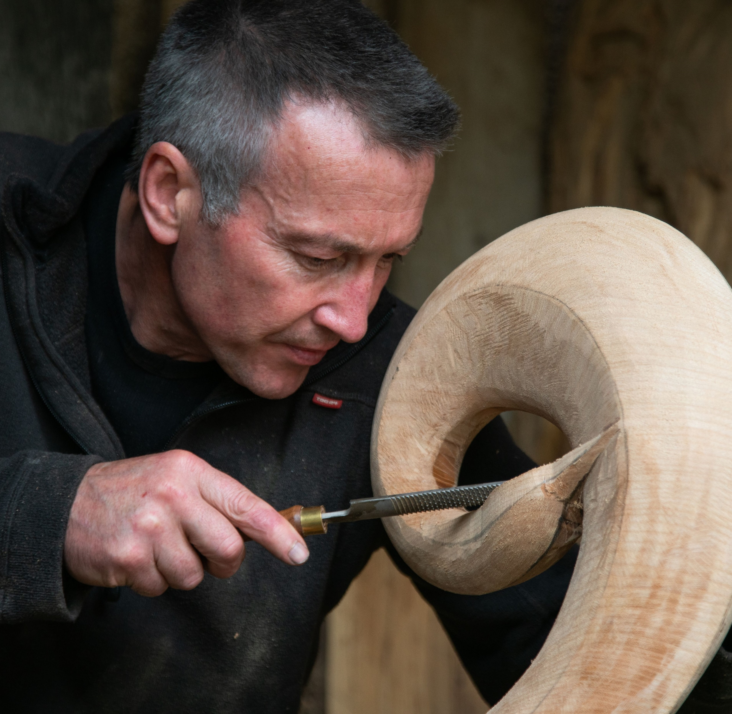
AGM 2023 Agenda
- Apologies for absence
- Approval of Minutes of AGM 2022 and matters arising
- Chair 2023 report including Treasurer; Co-Ordinator & Social Media reports
- Nomination/election of committee members
- Confirm Date of NEOS 2024
- Any other business

Slide 4
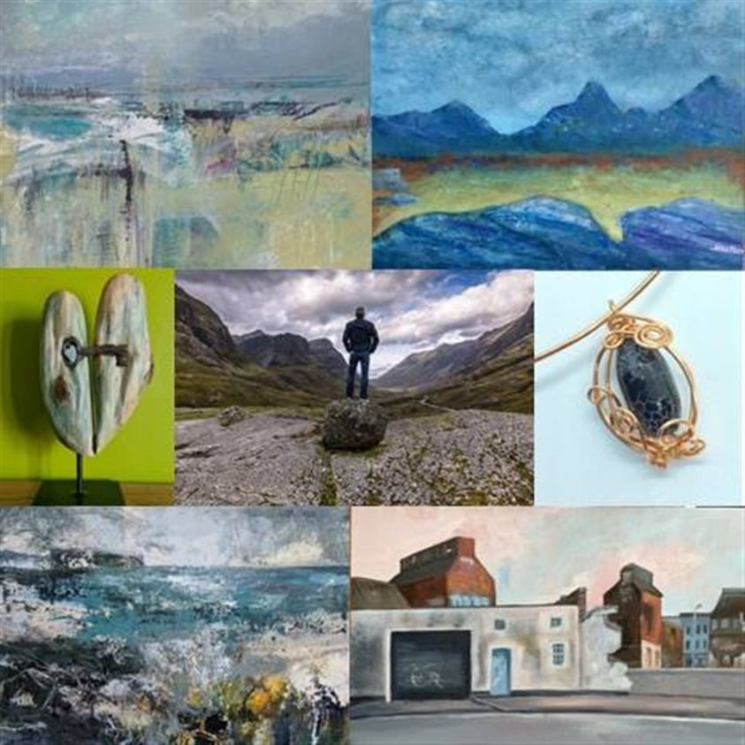
Chair Report 2023

Slide 5
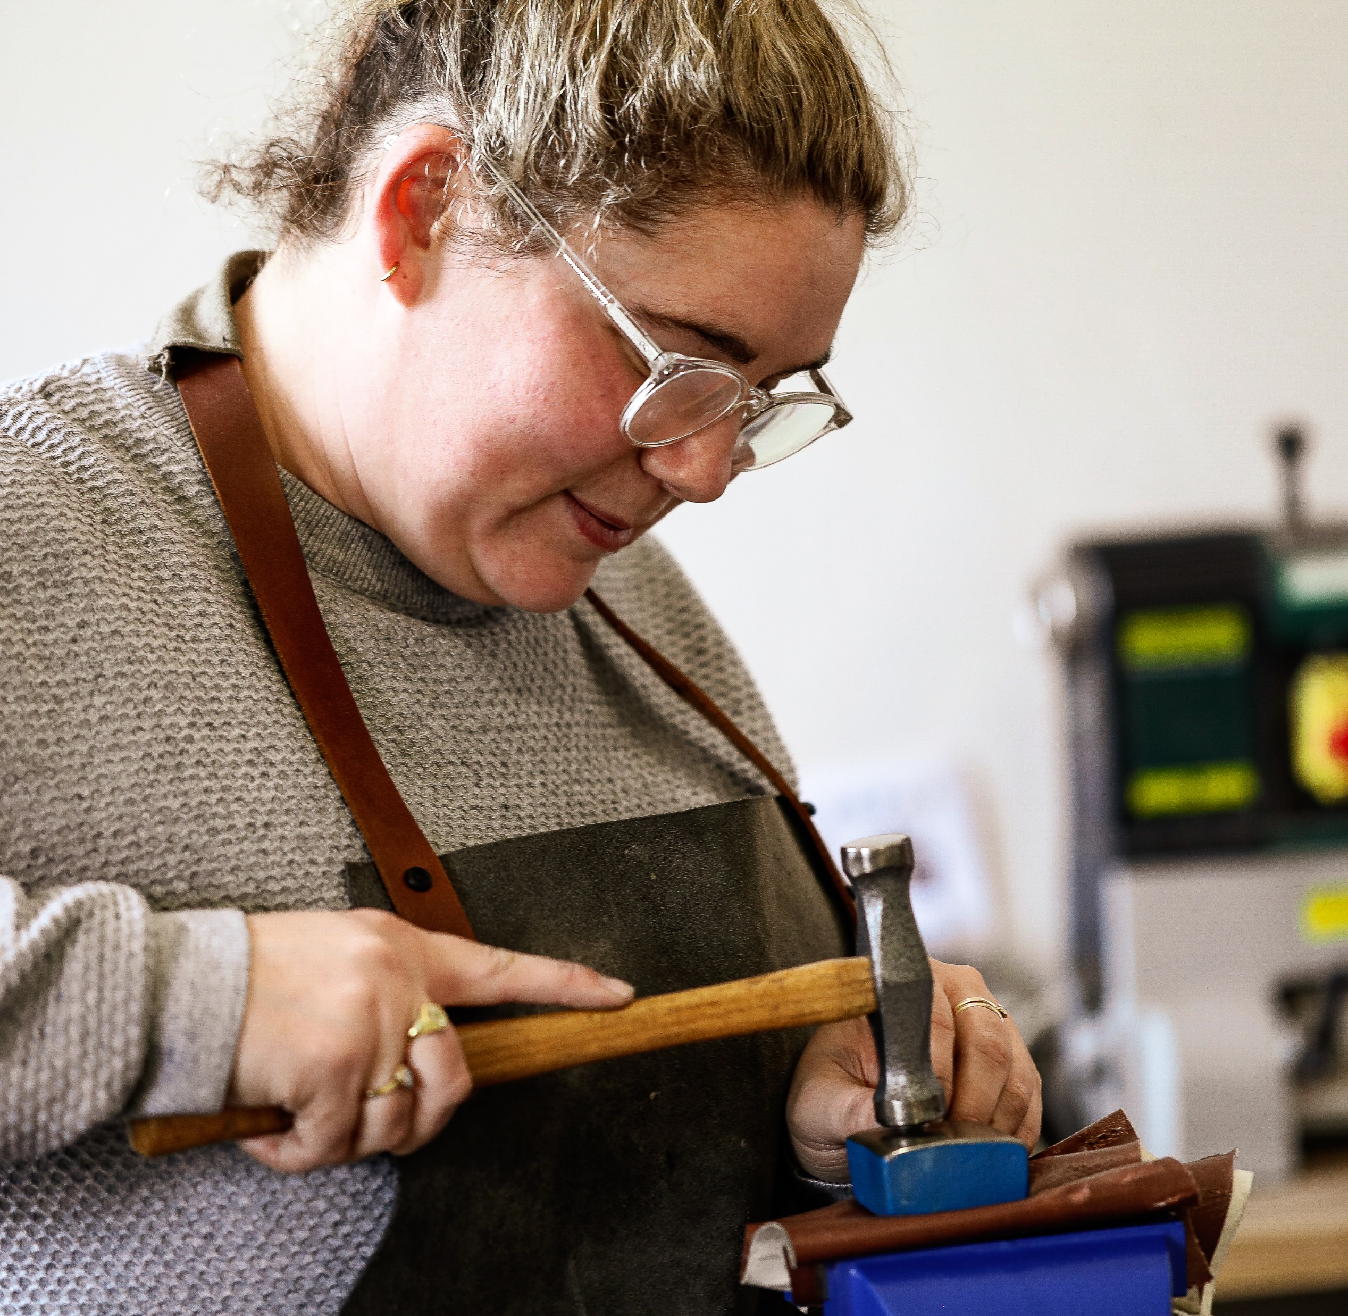
2023 Context/Activities
- Volatile economy
- 20th Anniversary of NEOS
- What makes NEOS unique
- Aim to grow audience
- Focus on housekeeping/governance:
Tenders for book print and signs
Review of Not-for-Profit status
Independent review of accounts
- £10K lottery funding for App and website
- Developing relationship with Visit Scotland and NESCol

Slide 6

The Book
- 20,000 printed
- More targeted approach (member suggestions)
- Library service, visitor centres, shops, Art Aboyne, members
- 1 box of 50 per member/ 3 boxes per group
- NEOS ownership of the template
- integrated map

Slide 7
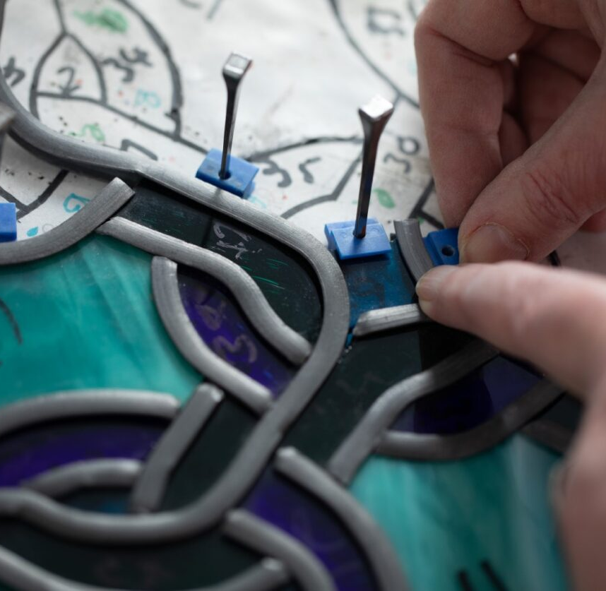
Advertising/promotion
- STV Growth Fund; cost NEOS £6k (for 12K campaign) 52 slots (15 peak) plus streaming
Pushing Out The Boat mag
¼ page in Artmag
£50 prize in Lifestyle mag
1500 postcards
1000 posters
3 x Press releases to all local and regional press.
Facebook £50 advert to boost app publicity
New NEOS signs

Slide 8

Downloaded by 2,114 people and used over 6,600 times
1,499 iphones/ipads; 665 Android phones
Usage peaked on 9 Sept with 515 launches
Daily unique users peaked at 315 on 9 Sept
Development cost £1500 + VAT
Ongoing cost £1,000 +VAT
Thanks to Atlas Live and the National Lottery Fund

Slide 9
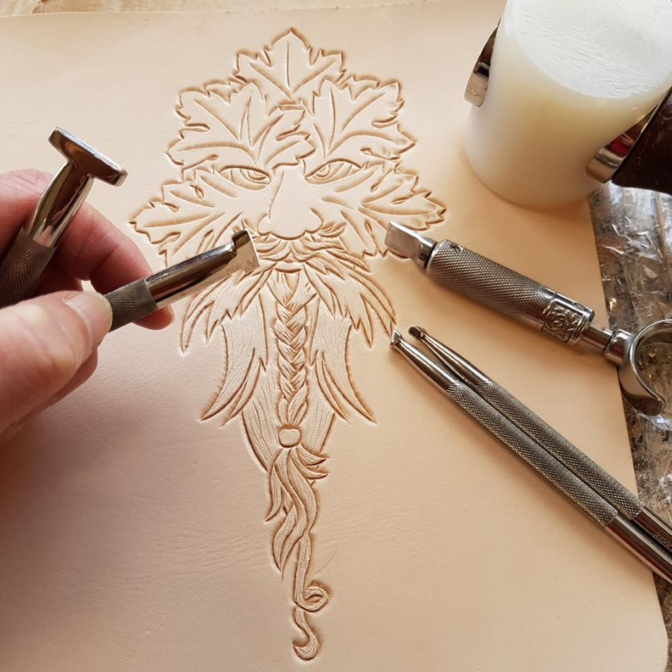
Website Insights
Jan-Oct 2023
1,709,000 hits (downloads) – peak in March and September
32,208 unique visits
Sept 2023
703,465 hits (downloads)
First weekend peak
New website under construction
Thank you to Connie and Linda for the online location guide

Slide 10
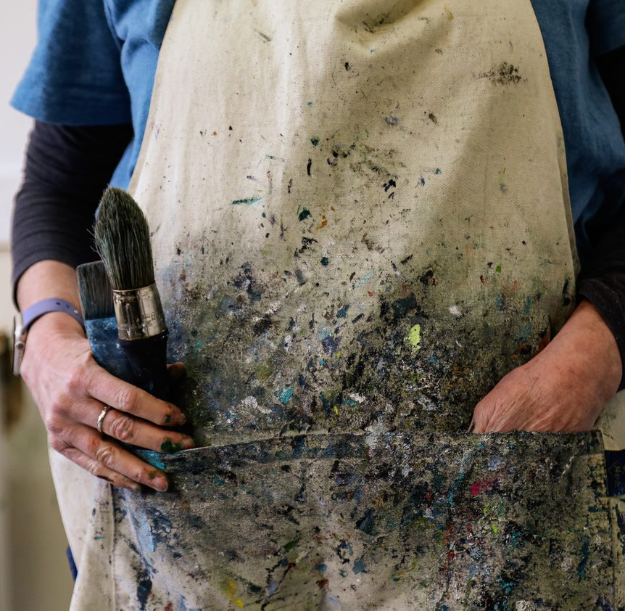
Member Communications
- Local get togethers hosted by experienced members in most geographical areas
- Approx 50 newsletter updates
- Internal Facebook
- New graphics and support
Thank you to Val, Charley and Linda

Slide 11
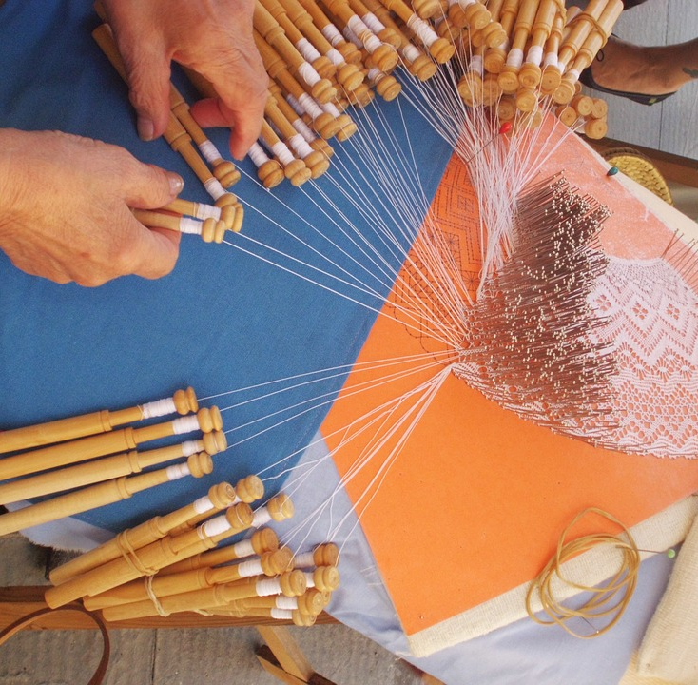
Member Survey Results
91 responses -most have done NEOS 3x or more
43% had more visitors than last year; 23% had less and 34% about the same.
74% had visitors new to NEOS
76% sold items
77% downloaded and used the app;
99% saw the social media campaign; 40% saw the STV ad; 23% saw press coverage.
70% would support STV ad again next year.
Majority met their objectives
Small number concerned about impact/competition from larger venues

Slide 12
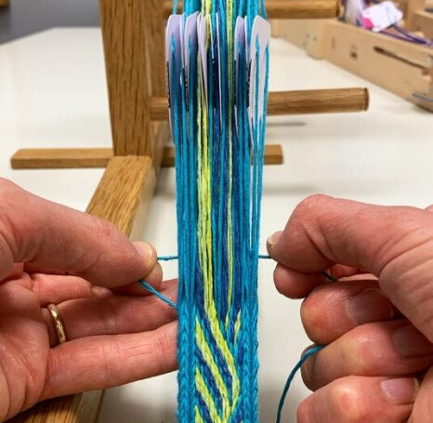
Visitor Survey Results
135 responses of which 18.5% were new
Mainly from the Grampian area
69% had a book – 95% of which used the integrated map; 40% downloaded the app. 1% remembered seeing the STV advert.
70% in age group 55+; slight increase in younger age groups
Main reasons for visiting were
To meet the makers (88%)
Buy direct from the makers (56%)
See finished work (66%)
Concerns/improvements – perceived drift to exhibitions rather than open studio experience.

Slide 13
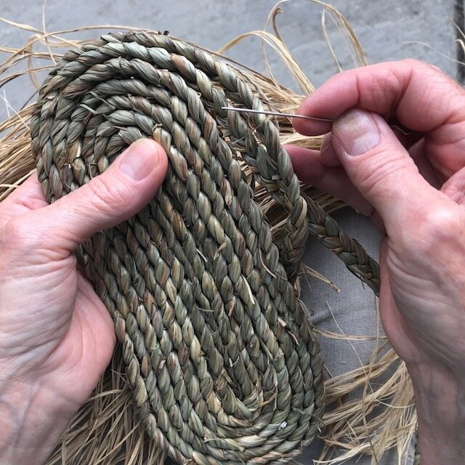
Treasurer’s Report
Carla Cummins

Slide 14
Summary | Income | Expenditure
Roll over from 2022 | £12,987
Membership fees | £43,280
Lottery grant | £10,000
Book production inc delivery |  | £21,417
Co-ordinator fee |  | £3,500
Social Media |  | £4,000
Advertising |  | £6,907
Admin/event delivery |  | £2,231
Website maintenance |  | £1,770
New website dev’t |  | £2,412
Mobile App |  | £1,800
New Signs |  | £1,984
Total | £66,267 | £45,121
In bank on 28/10/23
£21,146
New website
No proposal to increase membership fee for 2024

Slide 16

Co-ordinator’s Report
Louise Lemmon

Slide 17
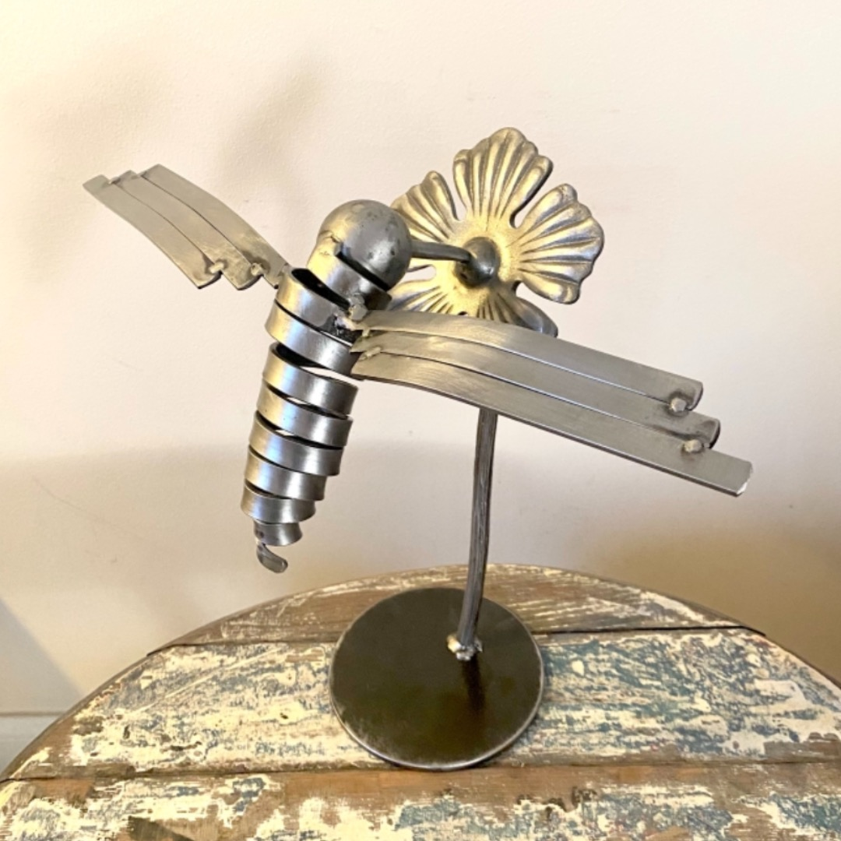
Co-ordinator Role
Assist members during sign up
Maintain and organise member database
Late/Incomplete Entries
Out of Area and Group Applications
Proofread (with committee members) members’ entries for book & website
Coordinate between the book designer and online location guide team
Edit members entries on the website
Organise Pick Up Points and Book Distribution

Slide 18
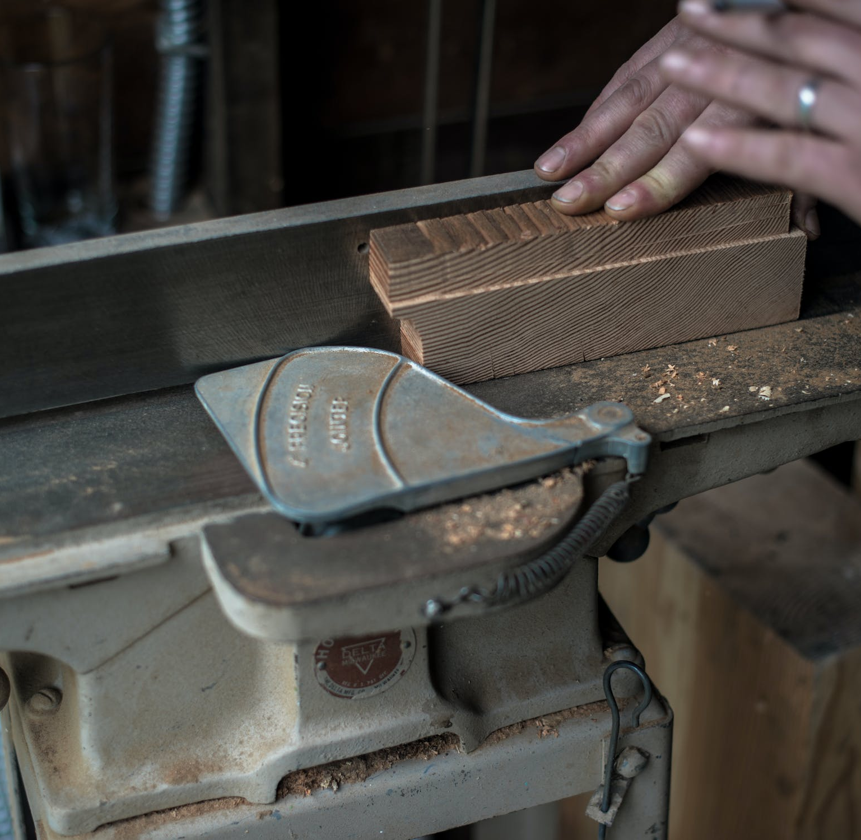
NEOS Membership 2023
Registration/Sign Ups = 295
(down 4% on last year)
Members Signed Up = 270*
(down 6% on last year)
Single Members = 251
Single Youth Members = 5
Small Group = 5
Large Group = 9
New Members = 55
(down 15% on last year)
*2 withdrawals

Slide 19

Social Media
Coordinator Report
Louise Lemmon

Slide 20
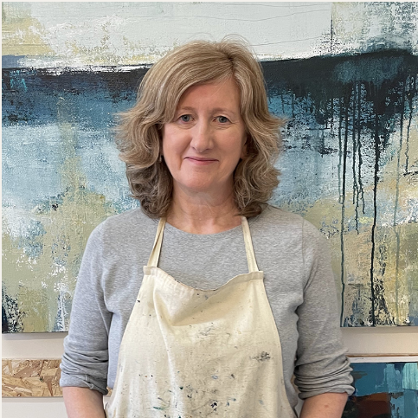
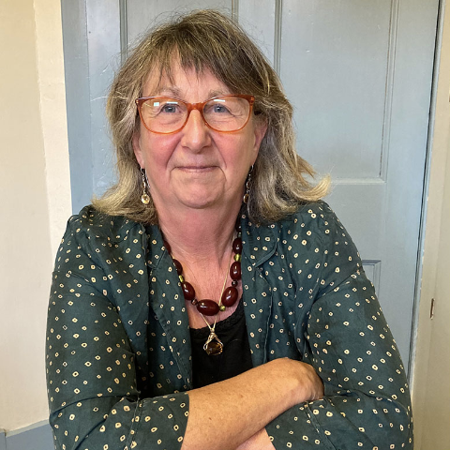
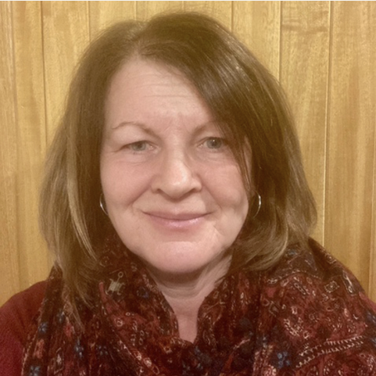
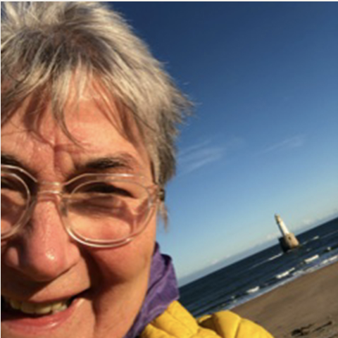
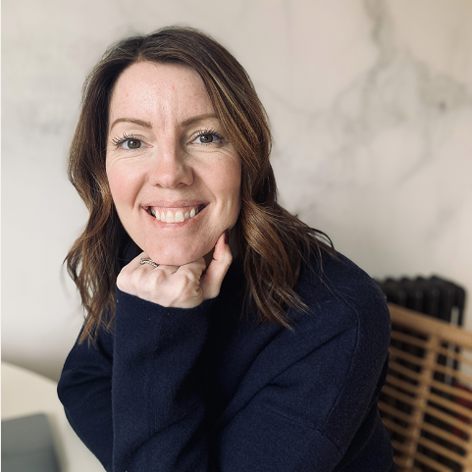
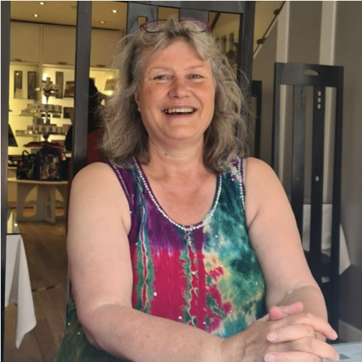
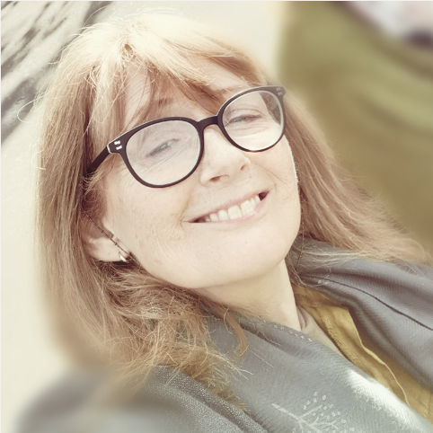
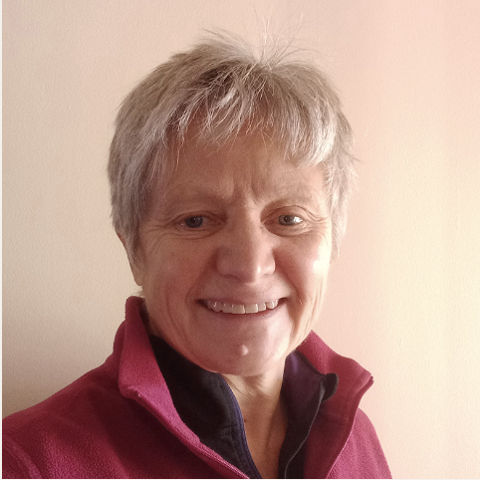
Overall Insights – Likes
Social Media Team – Facebook and Instagram

Slide 21

Social Media Co-ordinator Role
Agree the social media schedule from March (sign up) to September
Creation posts for each member
Support production of, and post, discipline videos
Analysis of social media outlets and report twice yearly (Sept and March)
Co-ordinate with social media response team as needed
Social media training through Business Gateway (5 sessions in 2023)

Slide 22
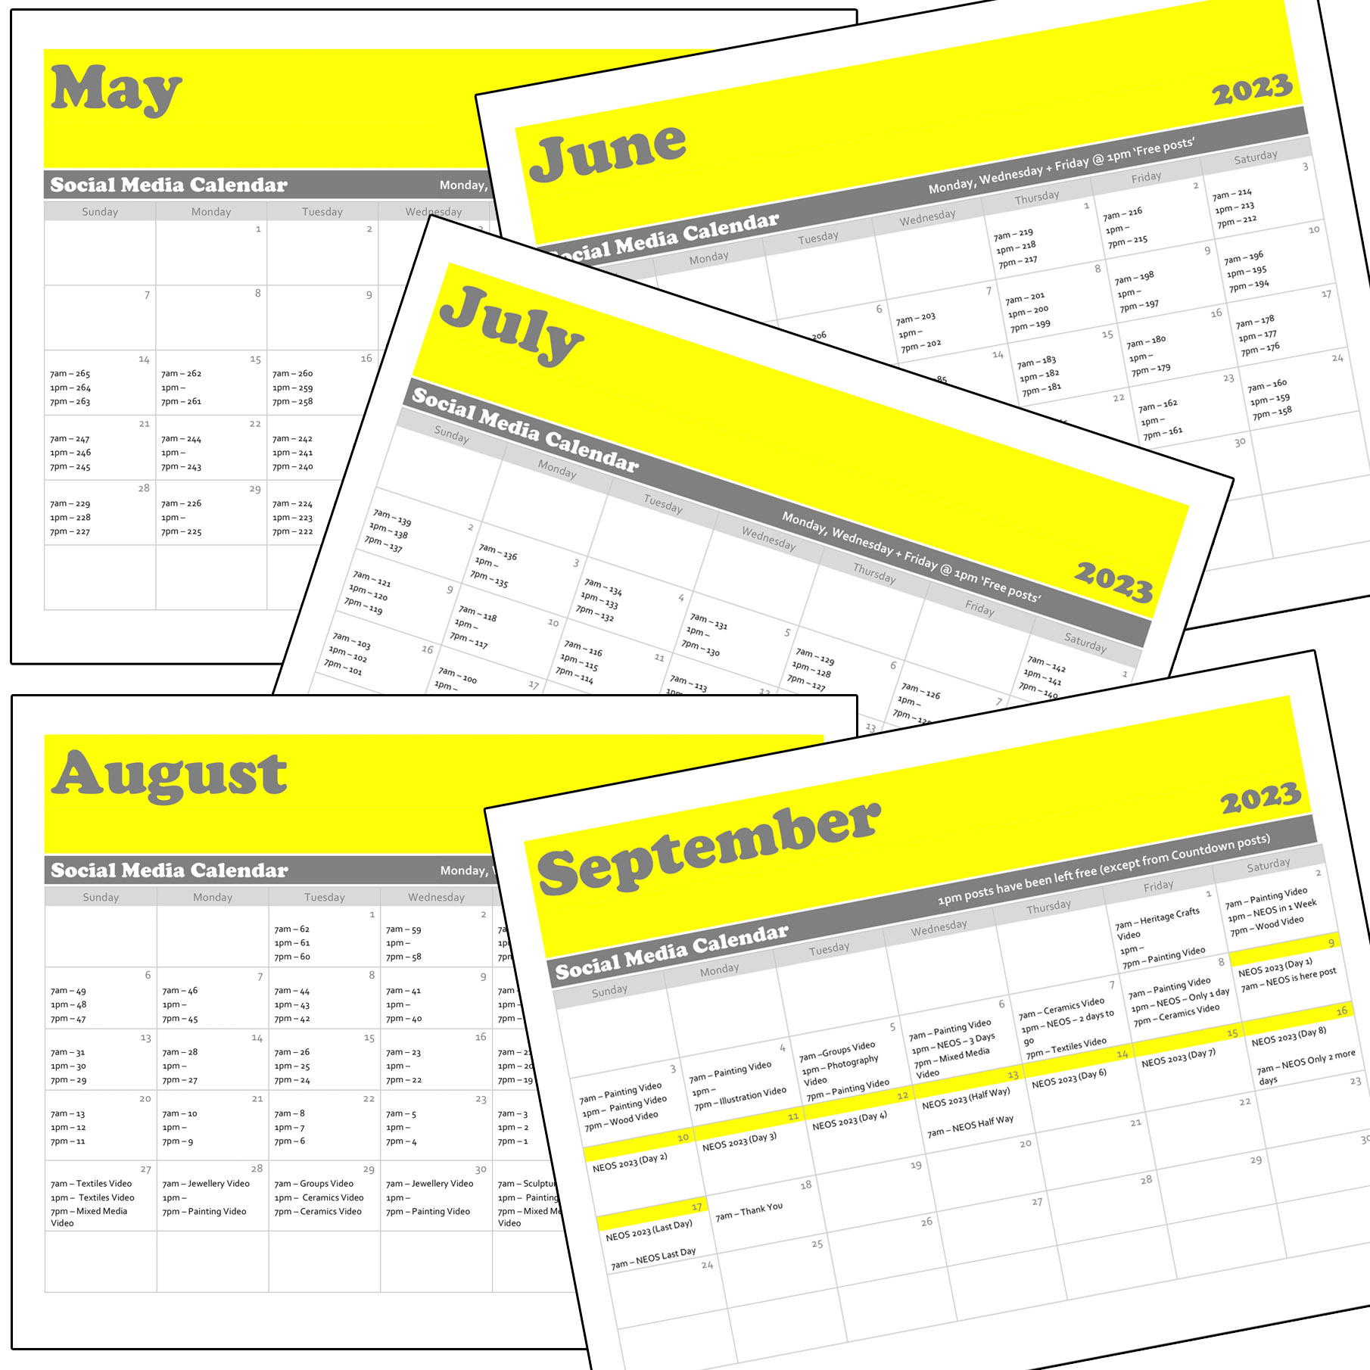
Scheduling
Campaign ran from 12th May – 8th September
268 Individual Members Posts
Z-A Format this year
36 Discipline videos
11 Countdown Graphics
Meta scheduling parameters changed. Posts could only be scheduled between 20 minutes and 29 days into the future.
Z-A Format this year
36 Discipline Videos

Slide 23
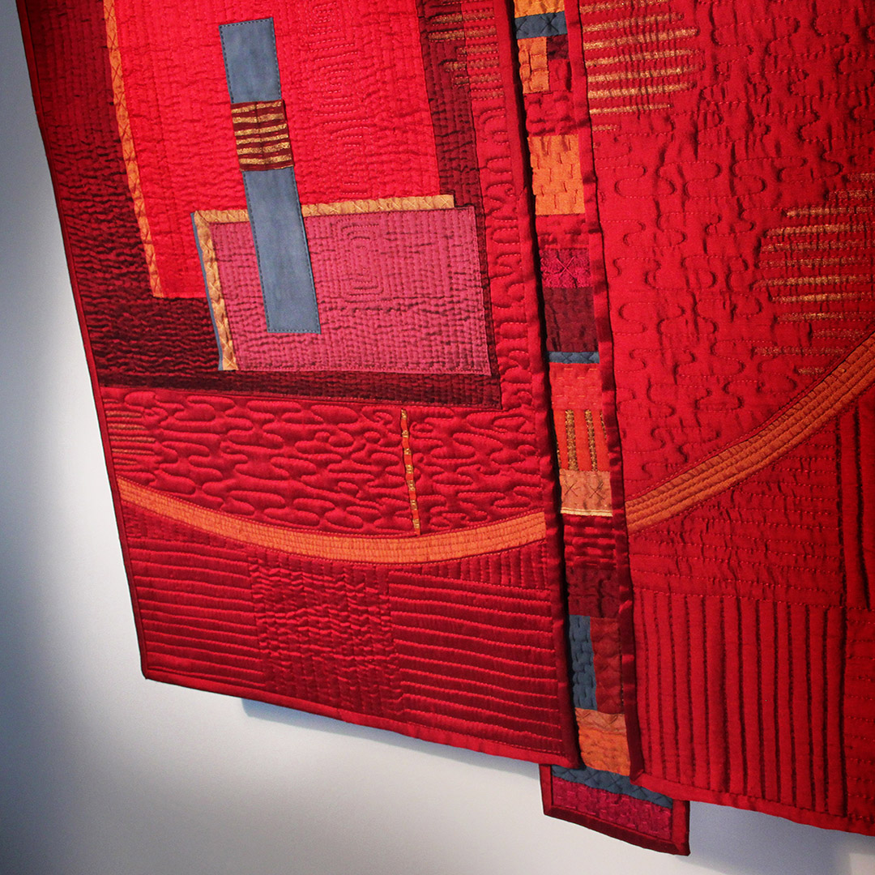
Individual Member's Posts
Highest ranking Member's Post -
Venue 146 - Mahri Prince Textile Artist
Published on Thursday 29th June
Reach 14.8K
15.9K impressions
Z-A Format this year
36 Discipline Videos

Slide 24
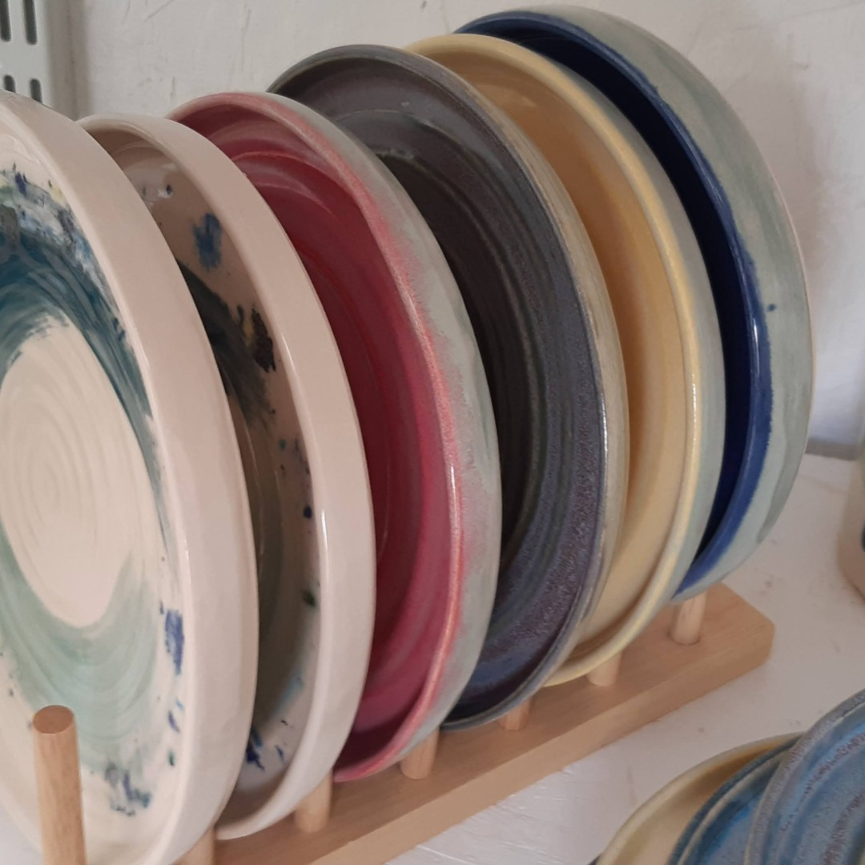
Discipline Videos
Highest ranking Video -
Ceramics 2
Published on Tuesday 29th August
Reach 2.9K
3.1K impressions
Z-A Format this year
36 Discipline Videos

Slide 25

Social Media Insights available on request
Z-A Format this year
36 Discipline Videos

Slide 26
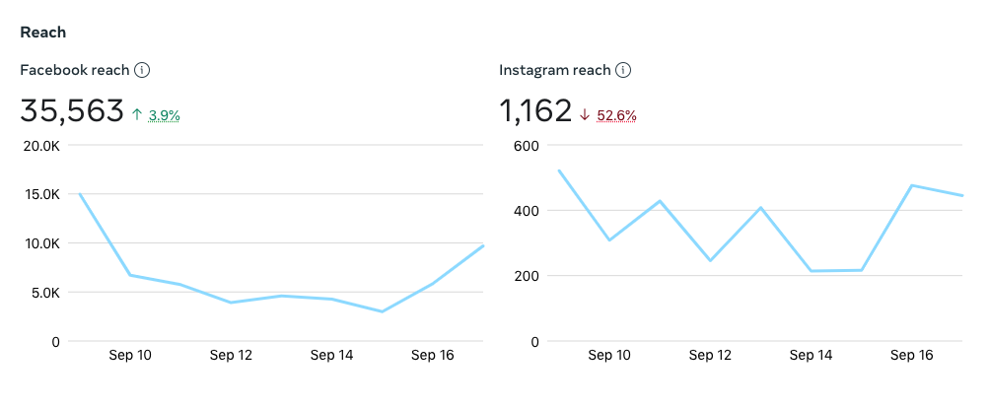
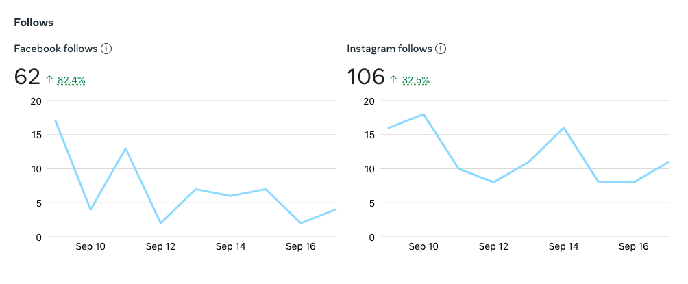
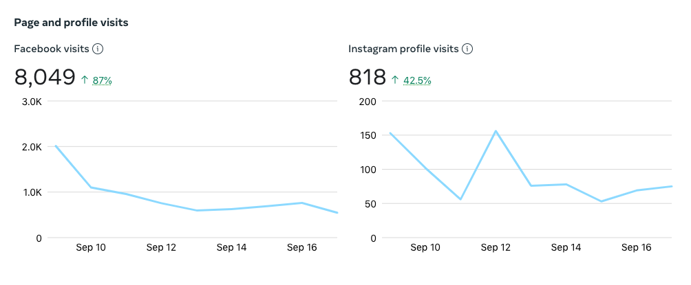
NEOS 2023
9th – 17th September 2023
The Event

Slide 27
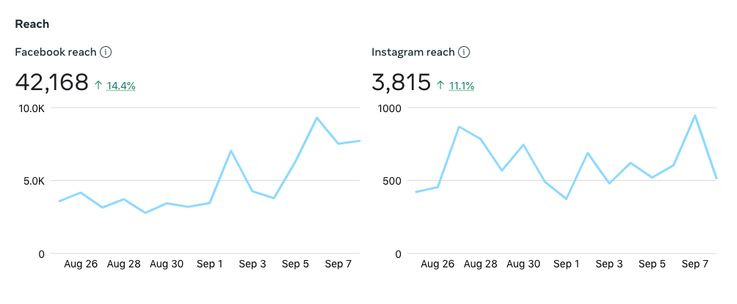
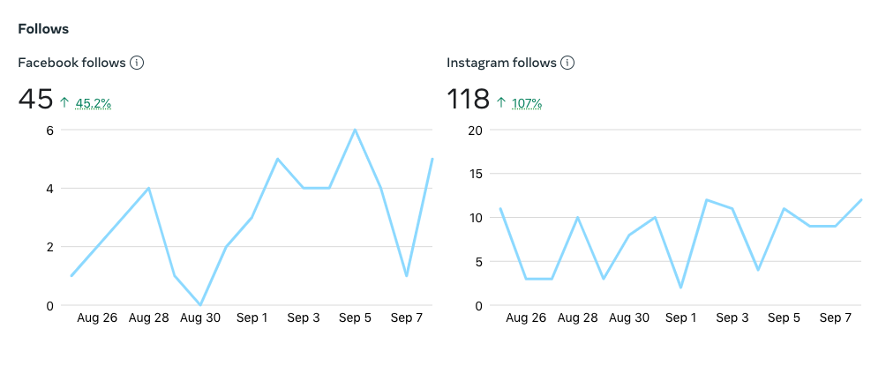
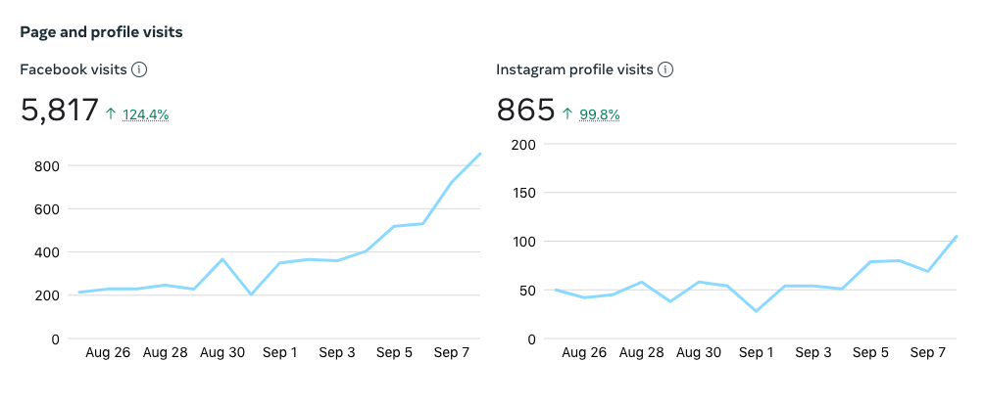
NEOS 2023
25th August – 8th September 2023
Discipline Videos

Slide 28
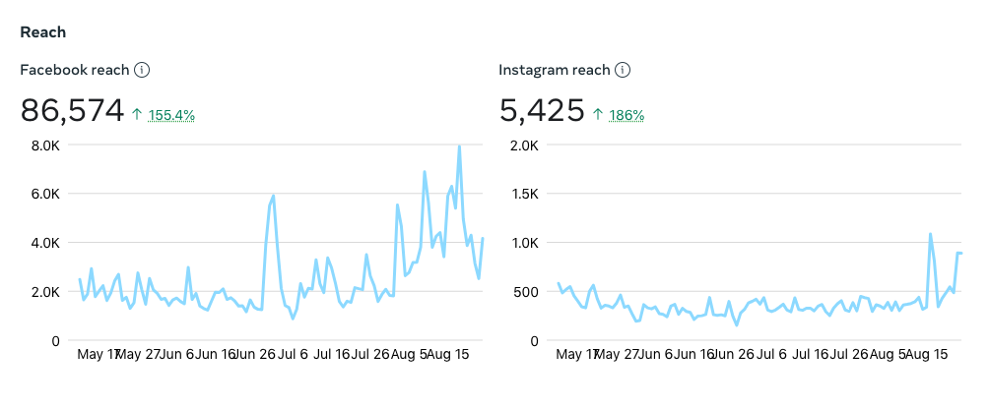
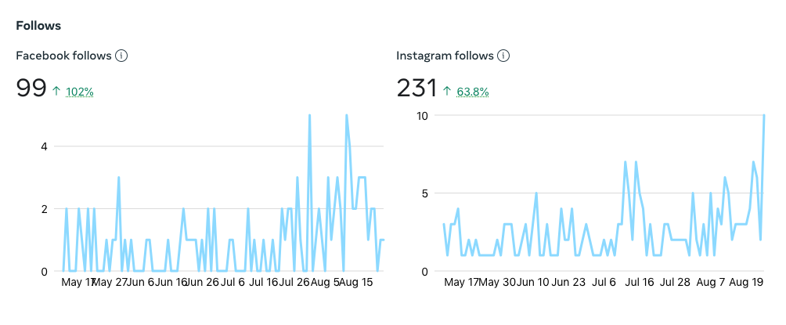
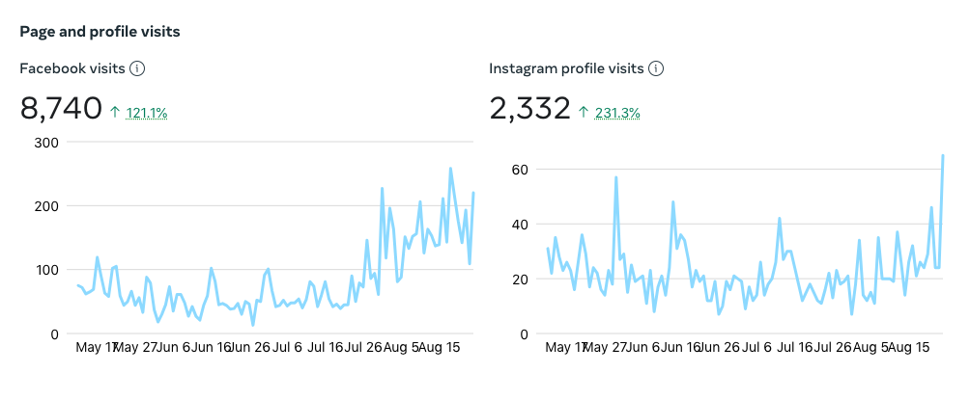
NEOS 2023
12th May – 24th August 2023
Individual Posts

Slide 29
Social Media Time Commitment
Individual member posts –creation, schedule and upload 70 hours +
36 discipline videos - creation, schedule and upload 80 hours +
Other NEOS posts (countdown etc) – 20 hours +
Liking and sharing member posts – 2 hours per day over August & September 70 hours +
Total committee time: approx. 240 hours+ (equiv of 2 months full time work)

Slide 30
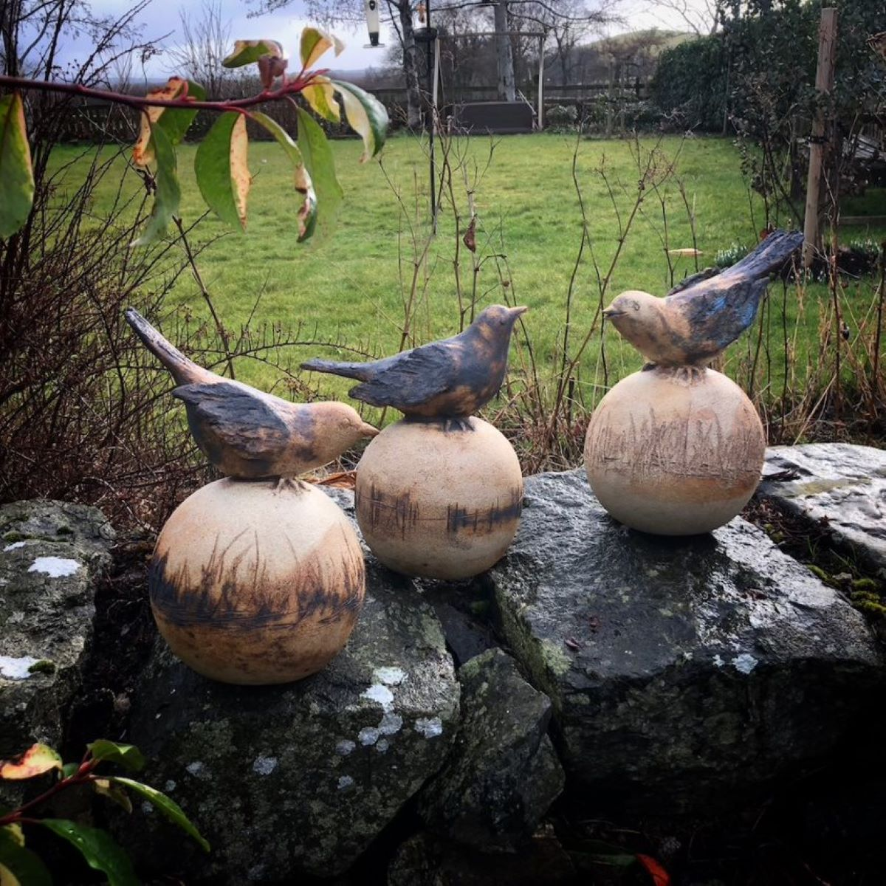
Discipline Videos
Pros
Provides a summary of Members
Cons
Time consuming to produces and schedule
Repetitive content
Reach performance low in comparison to individual/image posts
Z-A Format this year
36 Discipline Videos

Slide 31

Proposed changes to social media activity for NEOS 2024
No discipline videos will be created for social media (videos being considered for new website)
We will no longer share 3rd Party content
We will ask members to like and share each posts more – NEOS will no longer like and comment on member’s posts.
Individual posts for each member will be continued

Slide 32
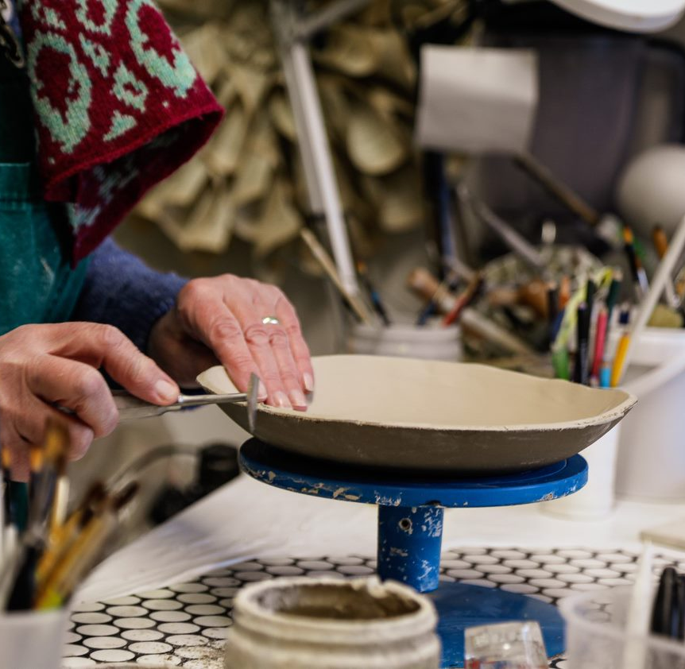
Thanks to the Committee of NEOS 2023
Chair – Lynne
Vice Chair – Charley
Secretary – Val
Treasurer – Amy/Carla
Co-ordinator- Louise
Social Media- Louise
New website – Paul
Linda, Brian, Mahri, Carol, Connie, Susie, Sara, Annie
Matt Robinson at Wiccan Brae
YOU HAVE BEEN AMAZING!

Slide 33
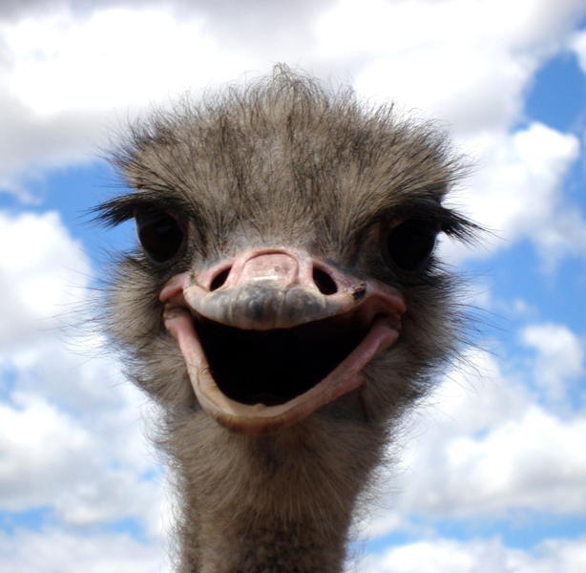
Any Questions/Comments?

Slide 34

Election of Committee 2024

Slide 35

Committee 2024 Nominations
Lynne Staples-Scott - Chair
Charley Sim - Vice Chair
Val Thomson - Secretary
Carla Cummins - Treasurer
Louise Lemmon - Co-ordinator
Linda Colquhoun
Carol Hiles
Connie Robertson
Paul Lawson
Brian Burnett
Shona Cammack
Tilly Howie

Slide 36
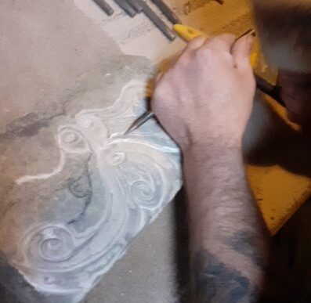
NEOS 2024
7-15th September
Any Other Business?
Thank you and safe journey home

